Slide 1

WIRELESS NETWORK DEPLOYMENT CONFIGURATION

Slide 2
Donia Hamdy Awad
Team members
Heba allah tarek fathy
Nehal Desouky Ismail
Yasmine Yahia Elmetwally
Supervised by
Eng. Amr Reda
Mariam Moustafa Mahmoud

Slide 3
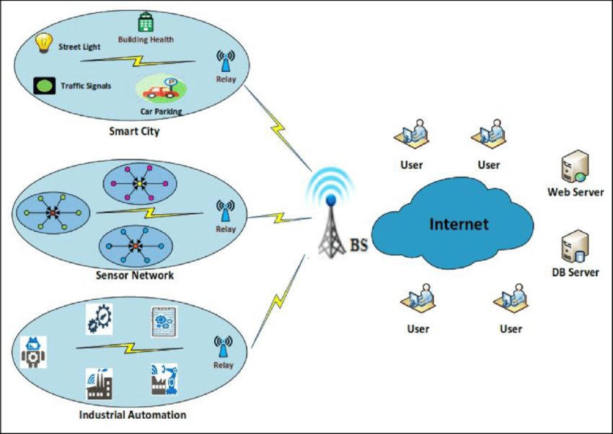
PROJECT OVERVIEW
Enterprise wireless
network simulation with IoT, WLC,
RADIUS authentication,
VLANs, and roaming
in Cisco Packet Tracer.

Slide 4

Project Purpose
To demonstrate how different wireless technologies
(like IoT, WPA2 Personal, and WPA2 Enterprise) can work together in one network, with secure user management using AAA.

Slide 5
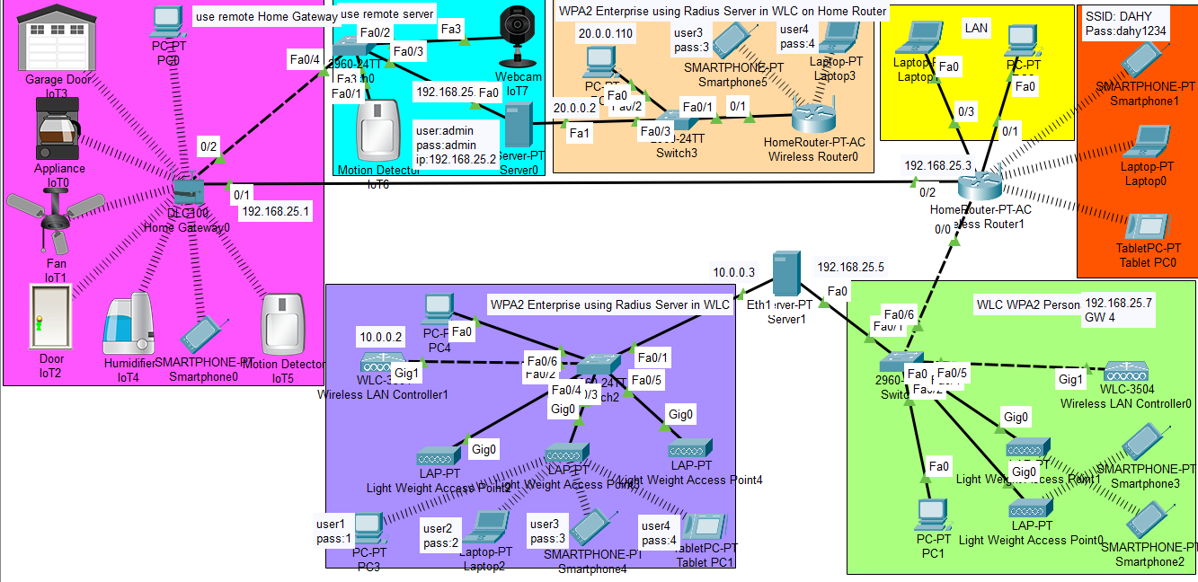
PHYSICAL TOPOLOGY

Slide 6
Configurations

Slide 7
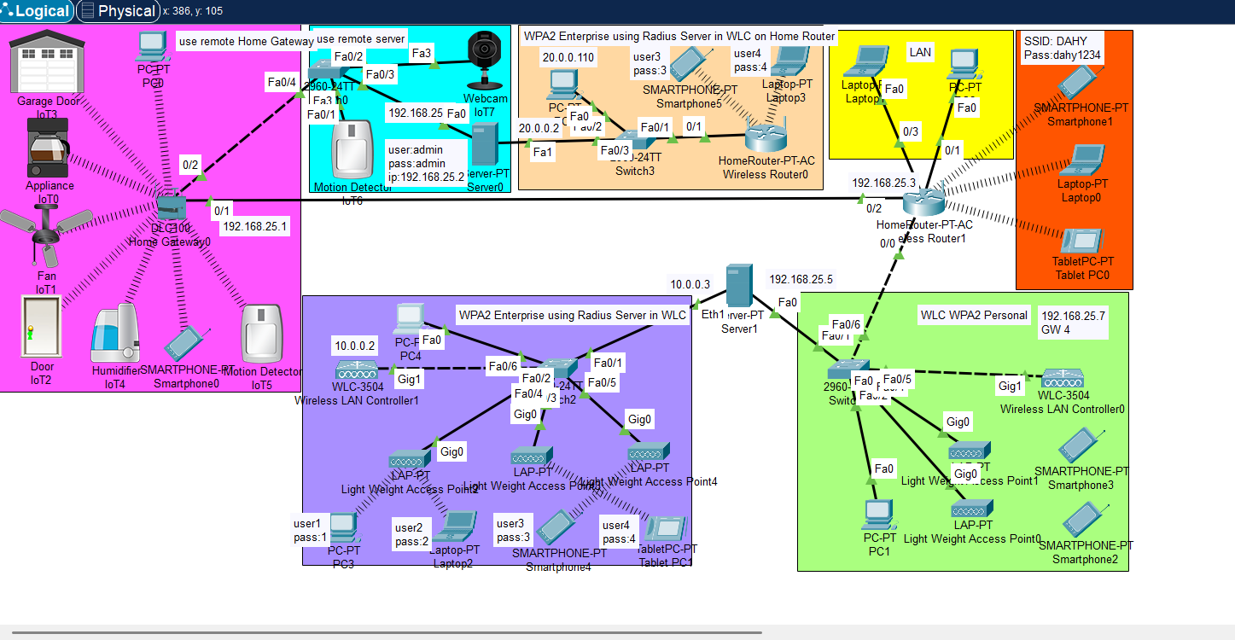
IOT(internet of things)
The IoT (Internet of Things) section simulates a smart home environment. It includes various smart devices connected to a central Home Gateway0, allowing control and monitoring over a network.

Slide 8
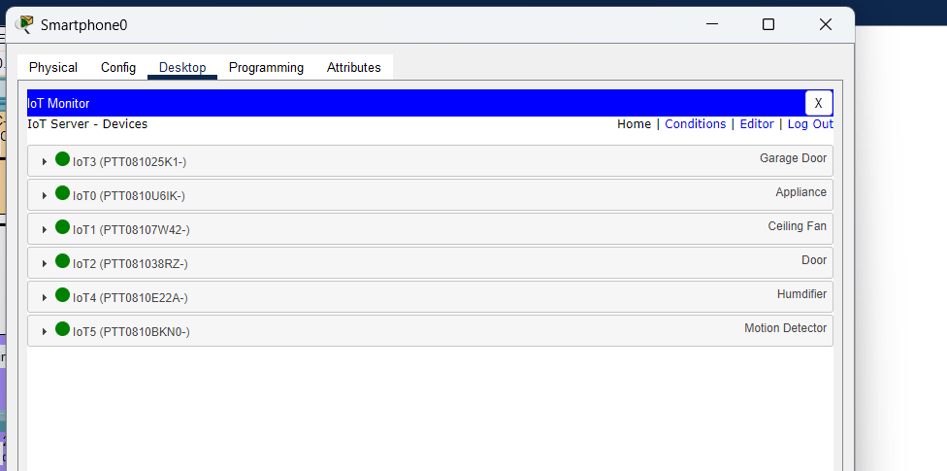
Using Smart phone to control IOT

Slide 9
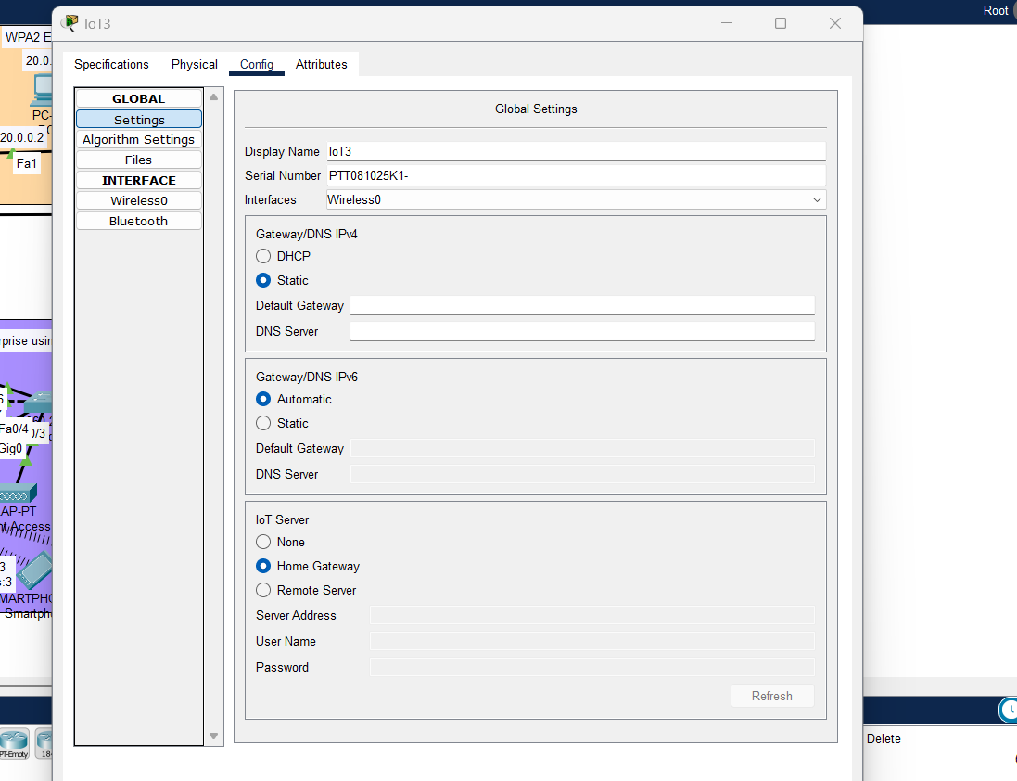
change the setting of the Devices

Slide 10
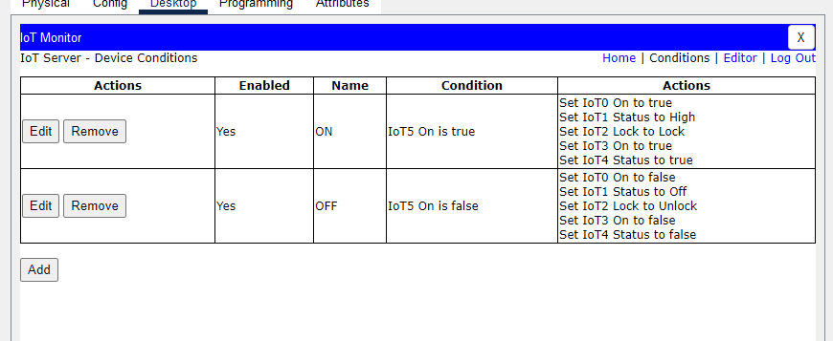
Make Conditions to control the Devices

Slide 11
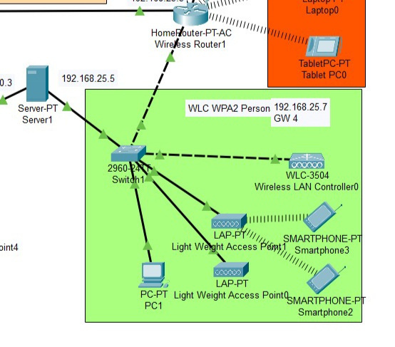
WLC WPA2 Personal

Slide 12
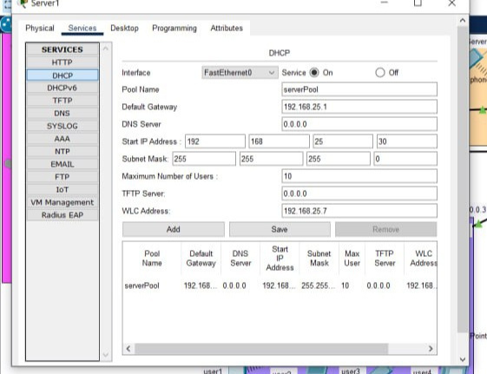
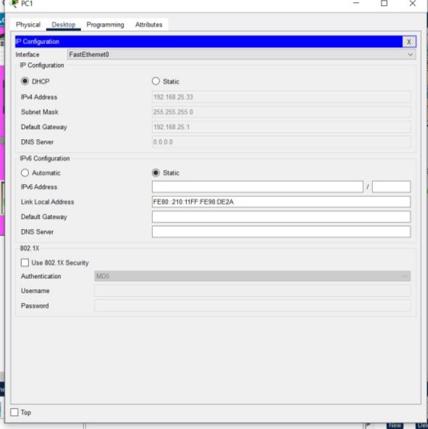
For WLC configuration
From RADIUS server that we put “sever 1” we will use DHCP and activated for the network
jthe pool name is serverPool , This pool is the distributor of the IP address for the 192.168.25.1 network to the devices there.

Slide 13
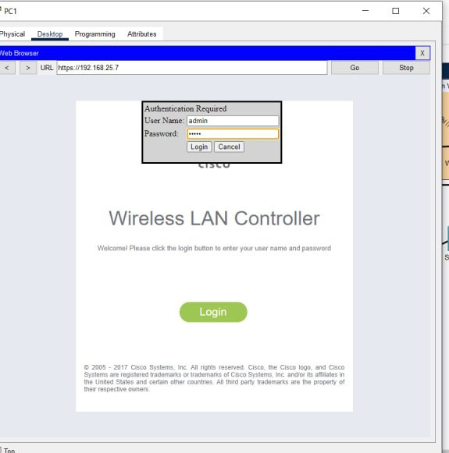
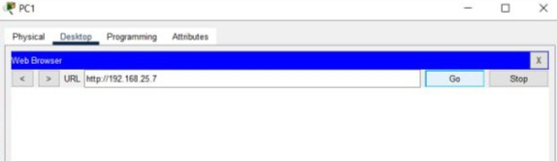
by ip we connected to
the page of wlc
uername: admin
password : admin

Slide 14
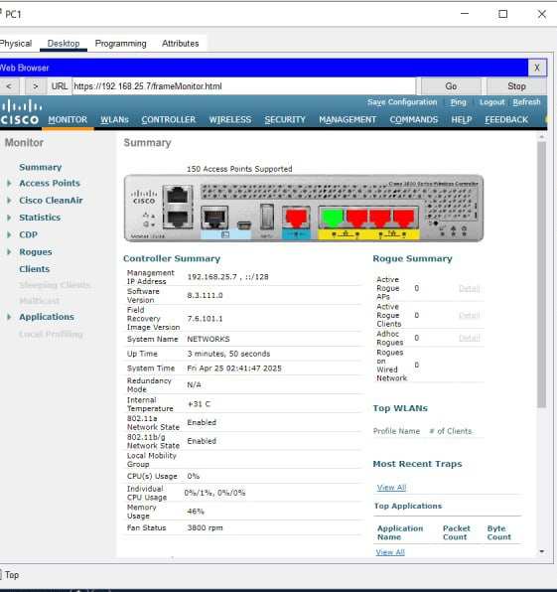
this is the WLC from inside

Slide 15
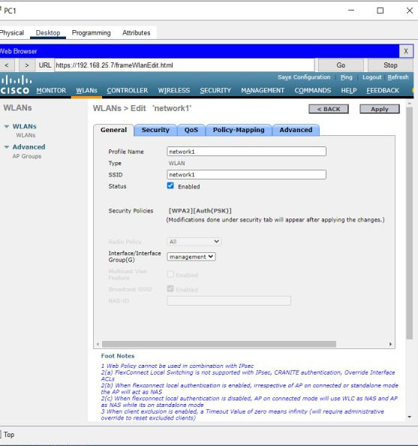
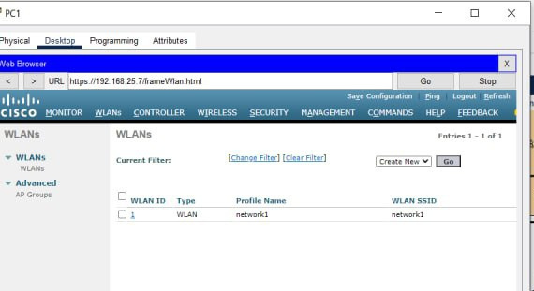
then from WLAN we can create a Network with name “ssid” the name of the network here is “ network 1”.

Slide 16
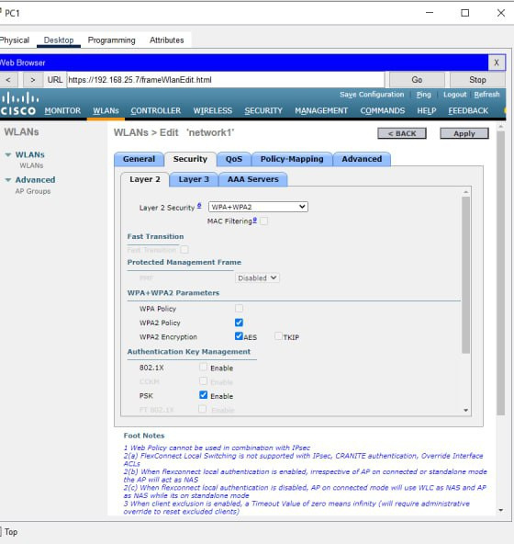
Security in WPA2 Personal WLAN:
In the WPA2 Personal configuration, the network uses a Pre-Shared Key (PSK) for authentication. This means that all users connect using the same password, which is manually configured on the Wireless LAN Controller (WLC). The data transmitted over the network is encrypted using AES, ensuring confidentiality and protection against eavesdropping. This method is simple to deploy and suitable for small to medium networks that do not require user-specific authentication.

Slide 17
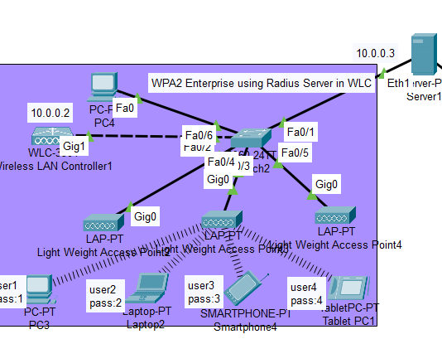
WPA2 Enterprise using Radius Server in WLC

Slide 18
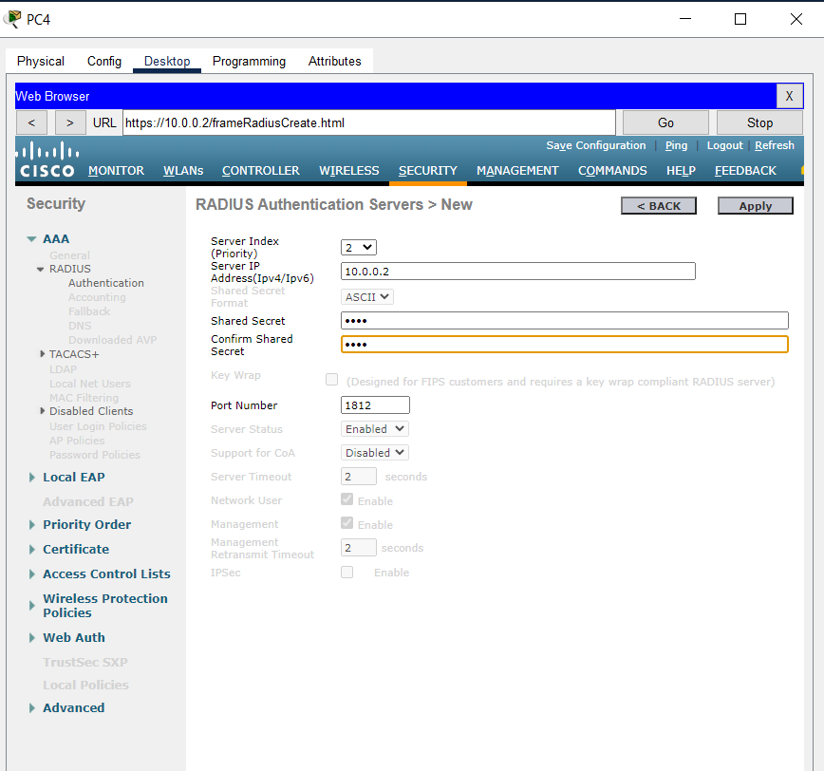
RADIUS server on WLC
RADIUS server (Remote Authentication Dial-In User Service) is used to authenticate users centrally. It checks user credentials and grants access.

Slide 19
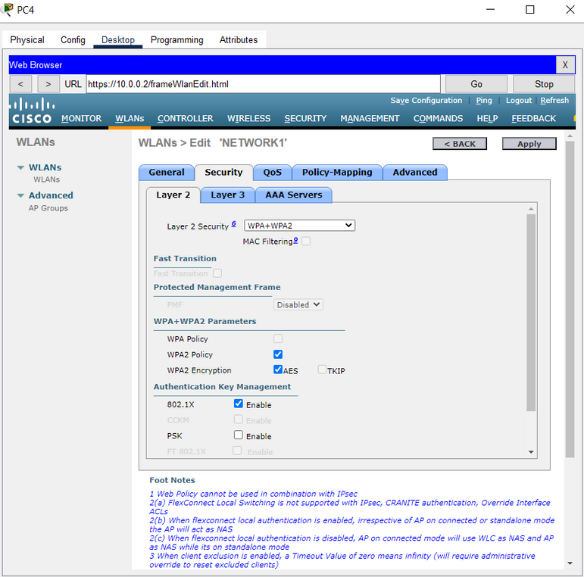
Enable Enterprise
WPA2-Enterprise is a Wi-Fi security protocol that uses individual credentials for each user instead of a shared password.

Slide 20
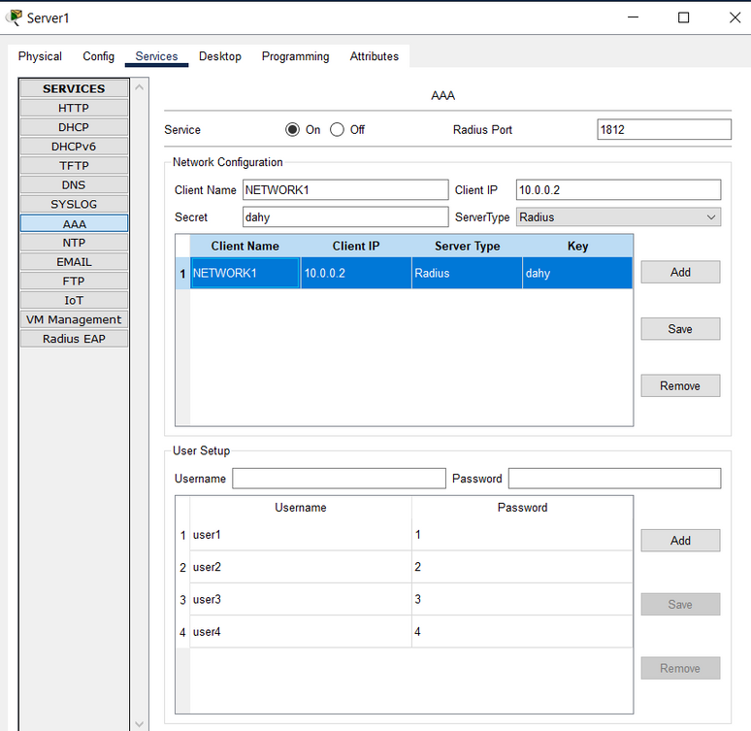
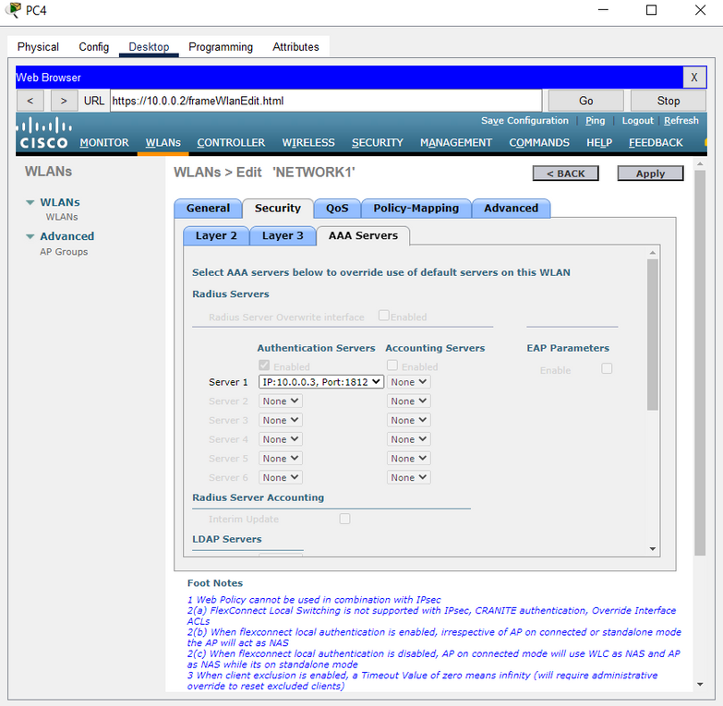
AAA on WLC & Server
Authentication:
The WLC forwards the user's Wi-Fi login to the RADIUS server, which verifies the credentials.
Authorization:
Once authenticated, the RADIUS server tells the WLC what access level to assign to the user.
Accounting:
The WLC logs session details (time, data usage) and sends them to the RADIUS server for tracking.

Slide 21
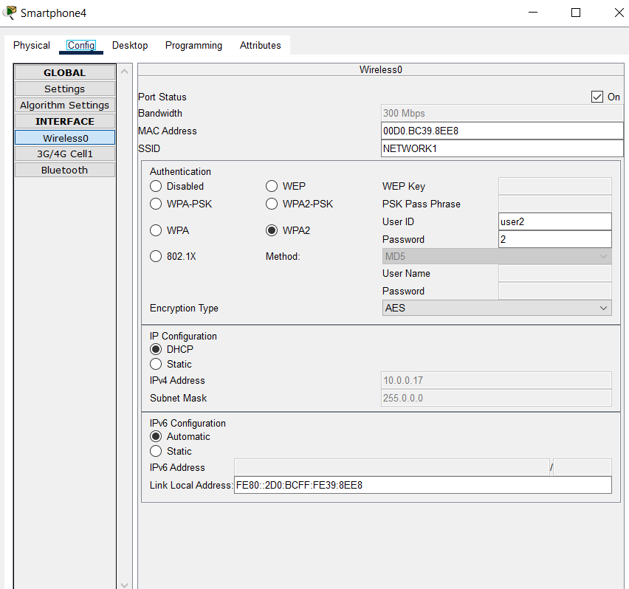
Adding the network on a smart phone
User ID: user2
Password: 2

Slide 22
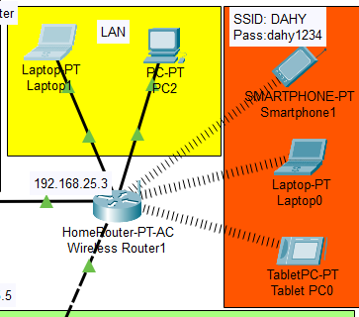
Home router
🟡 Wired Network (LAN)
This part of the network includes devices connected to the router through Ethernet cables (LAN). Wired networks offer higher stability and speed, especially for stationary or high-performance devices.
🔴 Wireless Network (SSID: DAHY)
This segment represents the wireless part of the home network. The router broadcasts a Wi-Fi network with the following details:
Network Name (SSID): DAHY
Password: dahy1234
Connection Type: Wireless (Wi-Fi)

Slide 23
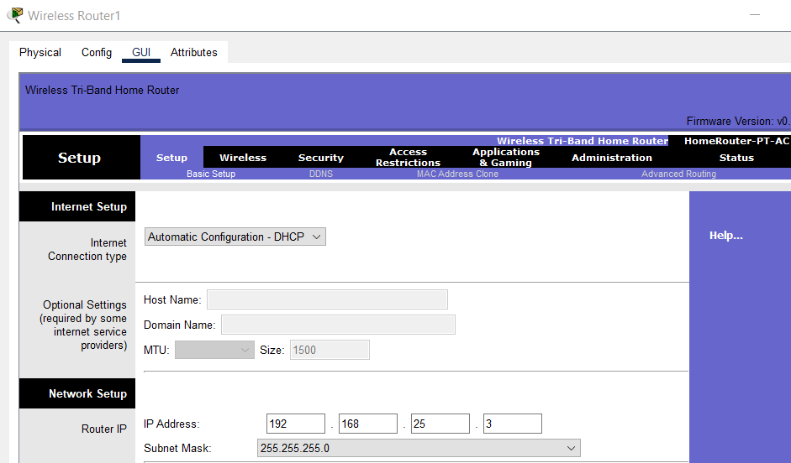
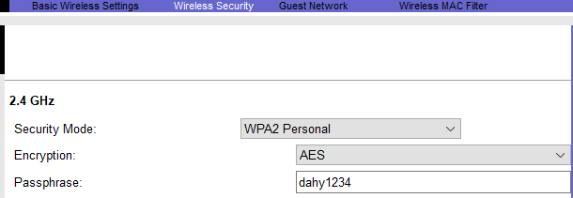
the Basic Setup page of the HomeRouter-PT-AC. The router is configured to obtain its IP automatically via DHCP, and its internal address is set to 192.168.25.3 . The DHCP server is disabled, so connected devices must use static IPs or receive their IP addresses from another DHCP server on the network.
Security Protocol: WPA2
Encryption Method: AES (Advanced Encryption Standard)

Slide 24
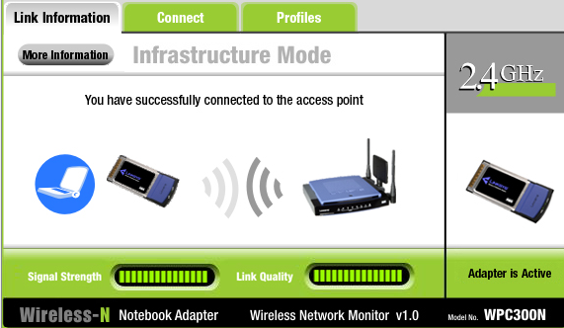
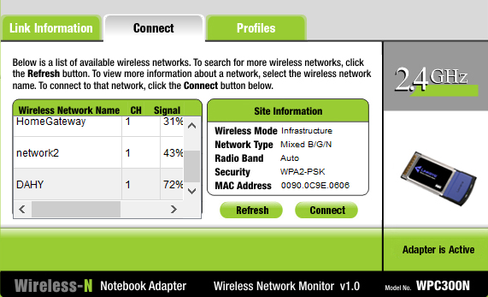
Adapter is Active → The wireless adapter is functioning correctly and ready to connect.
The interface is running on 2.4GHz, a common Wi-Fi band.
Wireless Network Monitor showing available Wi-Fi networks. The network 'DAHY' is selected, showing strong signal strength and WPA2-PSK security. This validates that the HomeRouter-PT-AC is correctly broadcasting the wireless network.

Slide 25
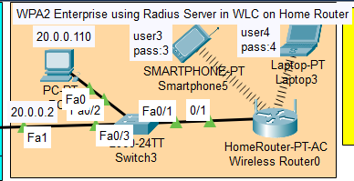
WPA2 Enterprise using Radius Server in WLC on Home Router

Slide 26
This setup uses WPA2 Enterprise security.
• Devices connect wirelessly through HomeRouter-PT-AC.
• Authentication is handled by a Radius Server inside the Wireless LAN Controller (WLC).

Slide 27
• HomeRouter-PT-AC – Wireless router broadcasting WPA2 Enterprise network.
• Switch3 – Connects the router to other devices.
• Radius Server (WLC-1) – Authenticates users via username and password.
• Devices – Laptop3, Smartphone4.

Slide 28
• Router IP: 192.168.25.3
• Network: 20.0.0.0/24
• Radius Server IP: 20.0.0.2

Slide 29
Authentication Process (Scenario)
1. User connects to the Wi-Fi using username & password.
2. HomeRouter-PT-AC forwards credentials to the Radius Server.
3. Radius Server checks credentials:
• If correct: access is granted.
• If incorrect: access is denied.
4. This provides individual access control for each user.

Slide 30
User Credentials Examples
• user3 / pass:3
• user4 / pass:4

Slide 32
THANK YOU

